Slide 1
Circular Economy and Urban Regeneration

Slide 2

“First life, then spaces, then buildings – the other way around never works”
Jan Gehl

Slide 3
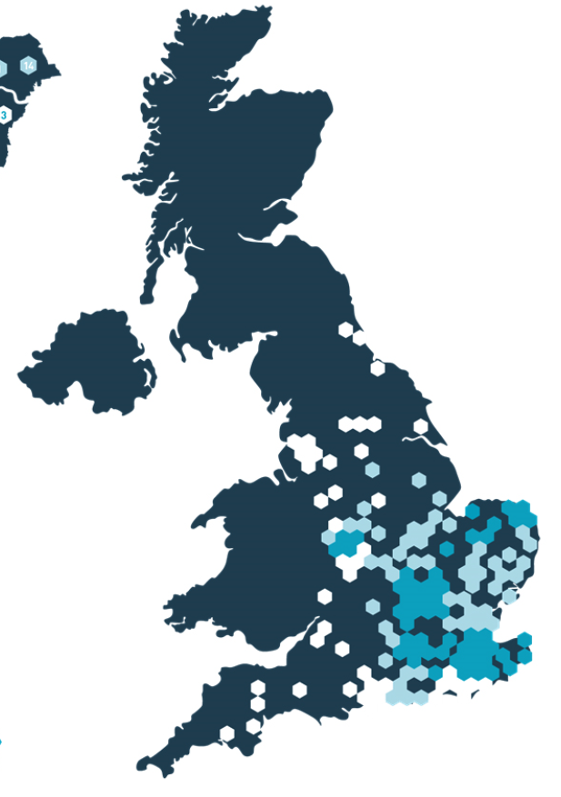
Clarion Housing Group
125,000 homes owned and managed throughout UK
We house 350,000 people
Build around 2,700 new homes each year
Target is 50,000 new homes in next ten years
£4 billion regeneration programme

Slide 4
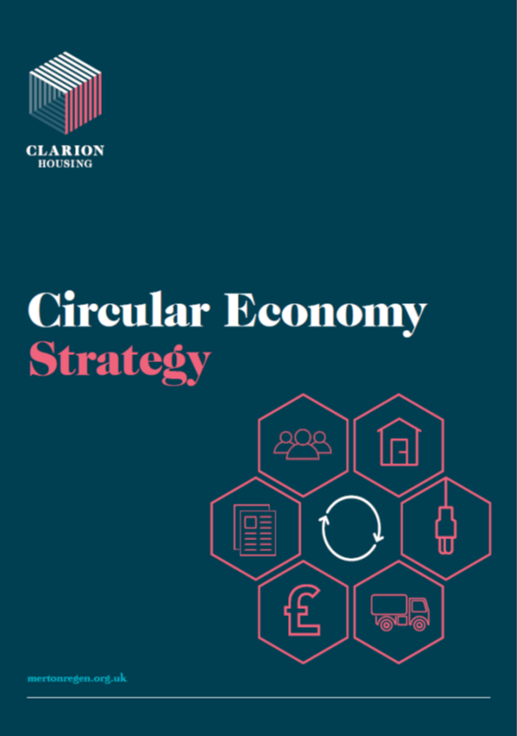
Clarion’s approach to Circular Economy

Slide 5

Circular Economy as DNA
Principles
Procurement
Delivery
Operation
End of Life

Slide 6
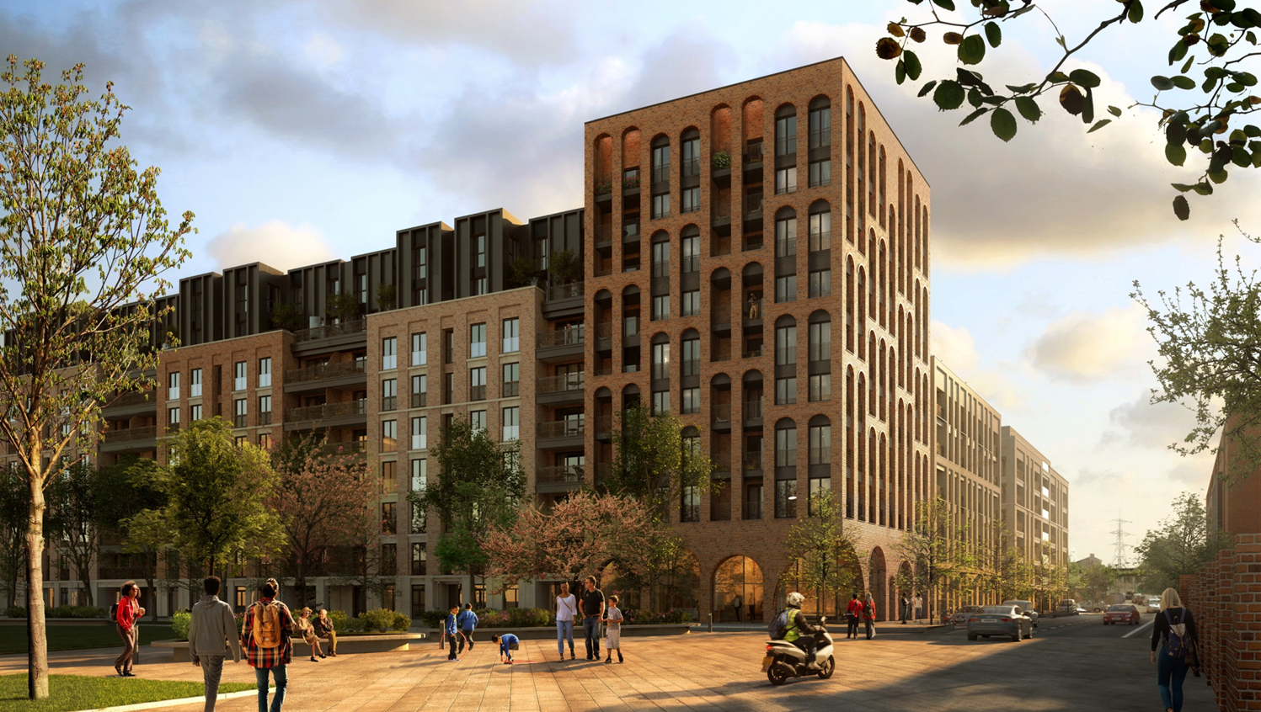
Based on three principles
1. Building in Layers
Designing out waste
Standardisation including off site and modular manufacturing
Buildings that are adaptable and easy to maintain
Buildings as a collection of reusable components

Slide 7
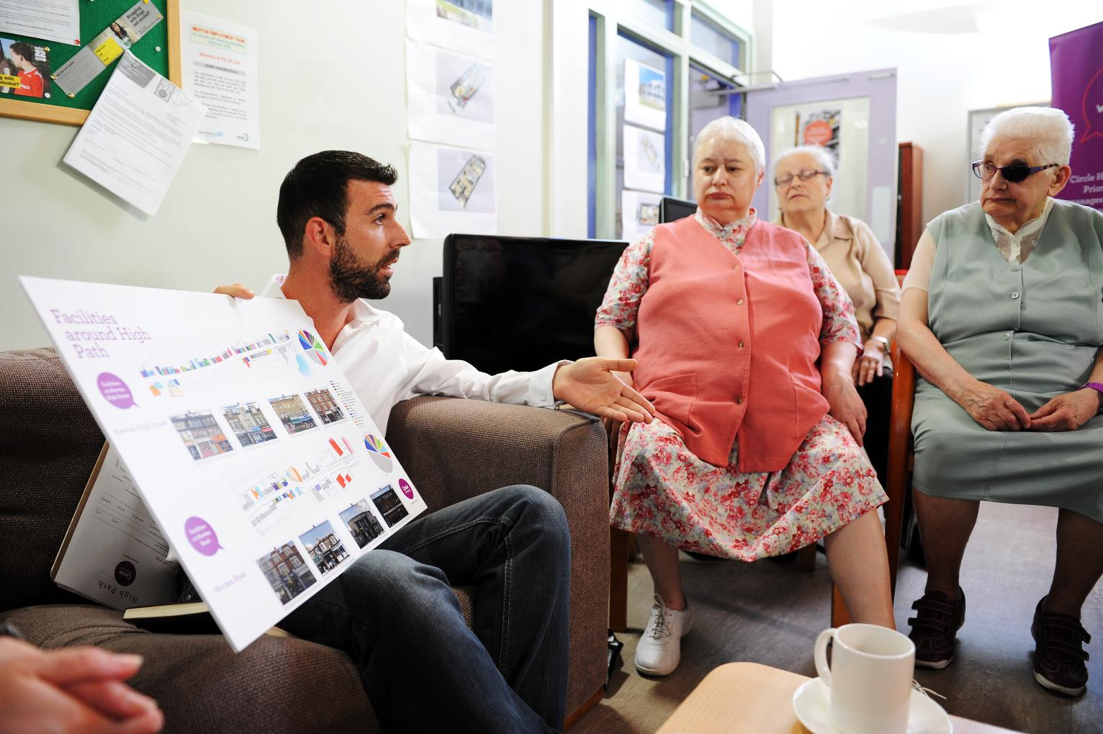
Based on three principles
2. Social Value
Community led design
Community re-use networks
Meanwhile strategies
Promote the sharing economy
Supporting household and community recycling

Slide 8
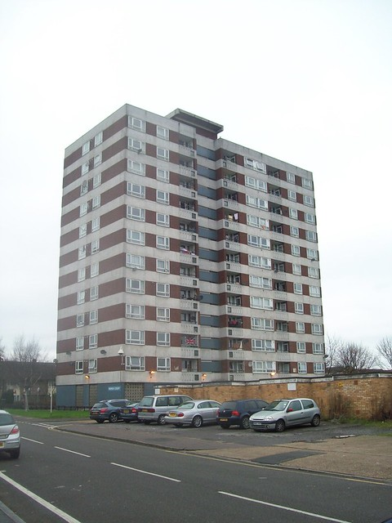
Based on three principles
3. Waste hierarchy
Demolition for maximum recovery value
Specify high recycle content/reused materials
Supply chain integration
Excellence in construction waste management
Deconstruction plans

Slide 9
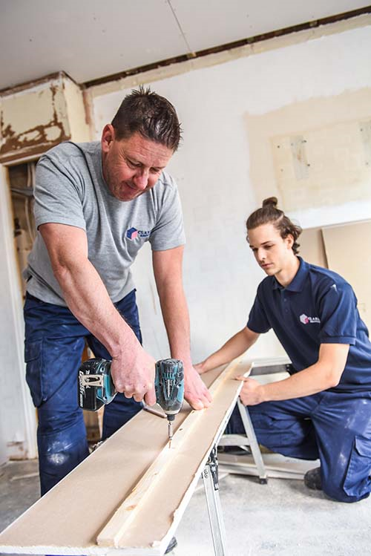

Practical delivery of CE: a series of stages
End of Life – existing buildings
Product and component stage
Construction Process
Use stage – as a place to live
Use Stage – maintenance, repair, adaption, replacement
End of Life – new buildings

Slide 10
Using our financial strength: procurement
Design
Demolition
Construction
Operation

Slide 11
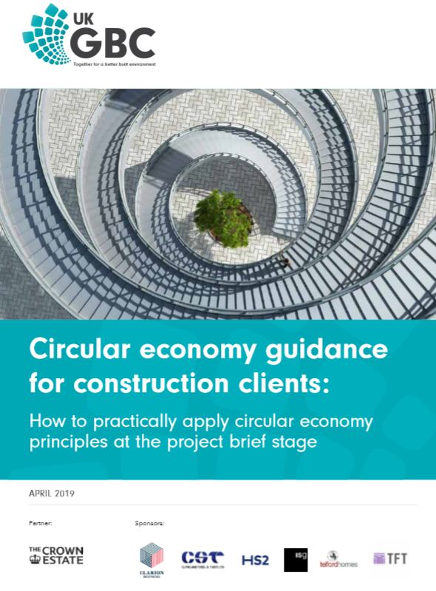
Circular Economy: Strategy
it’s not the same as a sustainability strategy!
We are right at the start
Proof of concept required
Policy will help….
….but delivery the real test

Slide 12
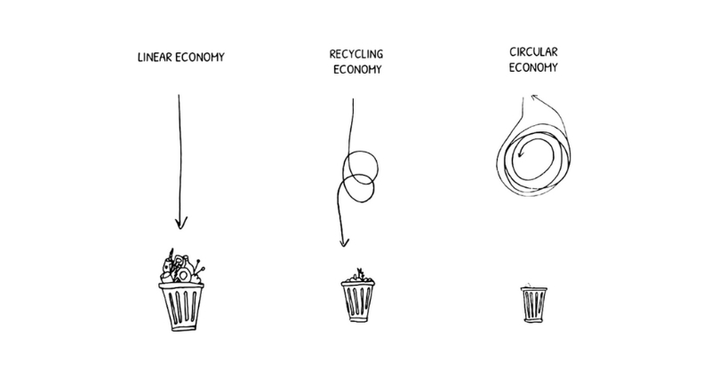
Leaving the linear economy behind…

